Slide 1

Python Programming Unit 5 (KNC-302)
Prepared By
Abhishek Kesharwani
Assistant Professor,UCER Naini,Allahabad

Slide 2
UNIT V
Iterators & Recursion:
Recursive Fibonacci
Tower of Hanoi
Search: Simple Search and Estimating Search Time
Binary Search and Estimating Binary Search Time
Sorting & Merging:
Selection Sort,
Merge List,
Merge Sort
Higher Order Sort

Slide 3
Recursion
Recursive Fibonacci
Tower Of Hanoi

Slide 4
Fibonacci series
In mathematical terms, the sequence Fn of Fibonacci numbers is defined by the recurrence relation
Fn = Fn-1 + Fn-2
with seed values F0 = 0 and F1 = 1.

Slide 5
The Fibonacci numbers are the numbers in the following integer sequence.
0, 1, 1, 2, 3, 5, 8, 13, 21, 34, 55, 89, 144, ……..

Slide 6
Fibonacci Number in Python
def Fibonacci(n): if n < 0: print("Incorrect input") # First Fibonacci number is 0 elif n == 1: return 0 # Second Fibonacci number is 1 elif n == 2: return 1 else: return Fibonacci(n - 1) + Fibonacci(n - 2) print(Fibonacci(int(input("Enter the number"))))

Slide 7
Tower of Hanoi
Tower of Hanoi is a mathematical puzzle where we have three rods and n disks. The objective of the puzzle is to move the entire stack to another rod, obeying the following simple rules:
1) Only one disk can be moved at a time.
2) Each move consists of taking the upper disk from one of the stacks and placing it on top of another stack i.e. a disk can only be moved if it is the uppermost disk on a stack.
3) No disk may be placed on top of a smaller disk.

Slide 8
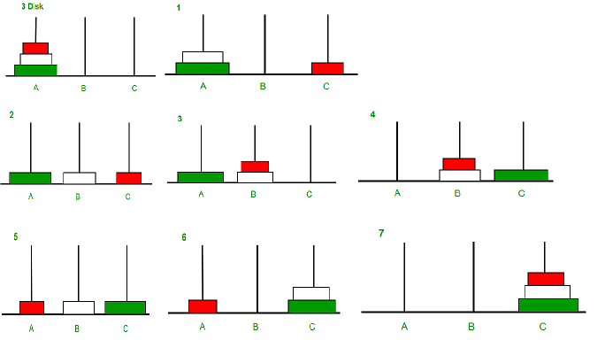

Slide 9
Python Program of Tower of Hanoi
def TowerOfHanoi(n, source, destination, auxiliary): if n == 1: print("Move disk 1 from source", source, "to destination", destination) return TowerOfHanoi(n - 1, source, auxiliary, destination) print("Move disk", n, "from source", source, "to destination", destination) TowerOfHanoi(n - 1, auxiliary, destination, source) # Driver code n = 3 TowerOfHanoi(n, 'A', ‘C', ‘B') # A, C, B are the name of rods

Slide 10
Output
Move disk 1 from source A to destination C
Move disk 2 from source A to destination B
Move disk 1 from source C to destination B
Move disk 3 from source A to destination C
Move disk 1 from source B to destination A
Move disk 2 from source B to destination C
Move disk 1 from source A to destination C

Slide 11
Python Iterators
An iterator is an object that contains a countable number of values.
An iterator is an object that can be iterated upon, meaning that you can traverse through all the values.
Technically, in Python, an iterator is an object which implements the iterator protocol, which consist of the methods __iter__() and __next__()

Slide 12
Return an iterator from a tuple, and print each value:
mytuple = ("apple", "banana", "cherry")
myit = iter(mytuple)
print(next(myit))
print(next(myit))
print(next(myit))

Slide 13
Strings are also iterable objects, containing a sequence of characters:
mystr = "banana"
myit = iter(mystr)
print(next(myit))
print(next(myit))
print(next(myit))
print(next(myit))
print(next(myit))
print(next(myit))

Slide 14
Create an Iterator
To create an object/class as an iterator you have to implement the methods __iter__() and __next__() to your object.

Slide 15
The __iter__() method acts similar, you can do operations (initializing etc.), but must always return the iterator object itself.
The __next__() method also allows you to do operations, and must return the next item in the sequence.

Slide 16
class MyNumbers: def __iter__(self): self.a = 1 return self def __next__(self): x = self.a self.a += 1 return x

Slide 17
myclass = MyNumbers() myiter = iter(myclass) print(next(myiter)) print(next(myiter)) print(next(myiter)) print(next(myiter)) print(next(myiter))
1
2
3
4
5

Slide 18
Search

Slide 19
Python Program for Linear Search
A simple approach is to do linear search
Start from the leftmost element of arr[] and one by one compare x with each element of arr[]
If x matches with an element, return the index.
If x doesn’t match with any of elements, return -1.

Slide 20
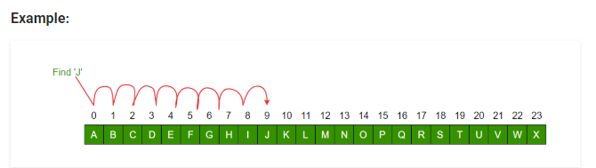

Slide 21
Code For Linear Search
def search(arr, x):
for i in range(len(arr)):
if arr[i] == x:
return i
return -1
NOTE: The time complexity of Linear Search is O(n)

Slide 22
Python Program for Binary Search
We basically ignore half of the elements just after one comparison.
Compare x with the middle element.
If x matches with middle element, we return the mid index.
Else If x is greater than the mid element, then x can only lie in right half sub array after the mid element. So we recur for right half.
Else (x is smaller) recur for the left half.

Slide 23
def binarySearch(arr, l, r, x): while l <= r: mid = (l + r ) //2; # Check if x is present at mid if (arr[mid] == x): return mid # If x is greater, ignore left half elif (arr[mid] < x): l = mid + 1 # If x is smaller, ignore right half else: r = mid - 1 # If we reach here, then the element was not present return -1

Slide 24
arr = [2, 3, 4, 10, 40] x = 10 length=len(arr) - 1 result = binarySearch(arr, 0, length, x)

Slide 25
Sorting & Merging

Slide 26
Selection Sort Algorithm
Selection sort is conceptually the most simplest sorting algorithm. This algorithm will first find the smallest element in the array and swap it with the element in the first position, then it will find the second smallest element and swap it with the element in the second position, and it will keep on doing this until the entire array is sorted.
It is called selection sort because it repeatedly selects the next-smallest element and swaps it into the right place.

Slide 27
Algorithm
Step 1 − Set MIN to location 0
Step 2 − Search the minimum element in the list
Step 3 − Swap with value at location MIN
Step 4 − Increment MIN to point to next element
Step 5 − Repeat until list is sorted

Slide 28




For the first position in the sorted list, the whole list is scanned sequentially. The first position where 14 is stored presently, we search the whole list and find that 10 is the lowest value.
So we replace 14 with 10. After one iteration 10, which happens to be the minimum value in the list, appears in the first position of the sorted list.

Slide 29


For the second position, where 33 is residing, we start scanning the rest of the list in a linear manner.
We find that 14 is the second lowest value in the list and it should appear at the second place. We swap these values.
After two iterations, two least values are positioned at the beginning in a sorted manner.

Slide 30
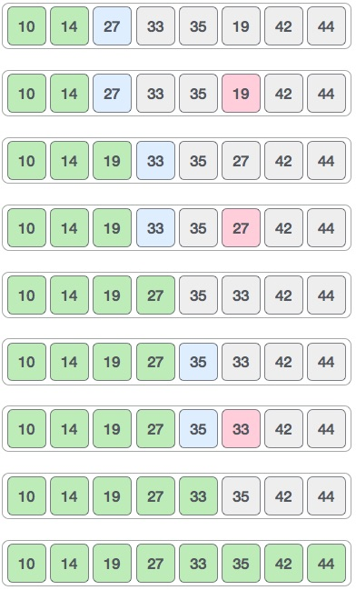

Slide 31
Complexity Analysis of Selection Sort
Selection Sort requires two nested for loops to complete itself.
Hence for a given input size of n, following will be the time and space complexity for selection sort algorithm:
Worst Case Time Complexity [ Big-O ]: O(n²)
Best Case Time Complexity [Big-omega]: Ω (n²)
Average Time Complexity [Big-theta]: θ(n²)
Space Complexity: O(1)

Slide 32
A = [64, 25, 12, 22, 11] for i in range(len(A)): min_idx = i for j in range(i+1, len(A)): if A[min_idx] > A[j]: min_idx = j A[i], A[min_idx] = A[min_idx], A[i] print ("Sorted array") for i in range(len(A)): print(A[i])

Slide 33
Merge Sort Algorithm
Merge Sort follows the rule of Divide and Conquer to sort a given set of numbers/elements, recursively, hence consuming less time.
Merge sort runs in O(n*log n) time in all the cases.
Before jumping on to, how merge sort works and it's implementation, first lets understand what is the rule of Divide and Conquer?

Slide 34
Divide and Conquer
If we can break a single big problem into smaller sub-problems, solve the smaller sub-problems and combine their solutions to find the solution for the original big problem, it becomes easier to solve the whole problem.
In Merge Sort, the given unsorted array with n elements, is divided into n sub-arrays, each having one element, because a single element is always sorted in itself. Then, it repeatedly merges these sub-arrays, to produce new sorted sub-arrays, and in the end, one complete sorted array is produced.

Slide 35
The concept of Divide and Conquer involves three steps:
Divide the problem into multiple small problems.
Conquer the subproblems by solving them. The idea is to break down the problem into atomic subproblems, where they are actually solved.
Combine the solutions of the subproblems to find the solution of the actual problem.
https://www.hackerearth.com/practice/algorithms/sorting/merge-sort/visualize/

Slide 36
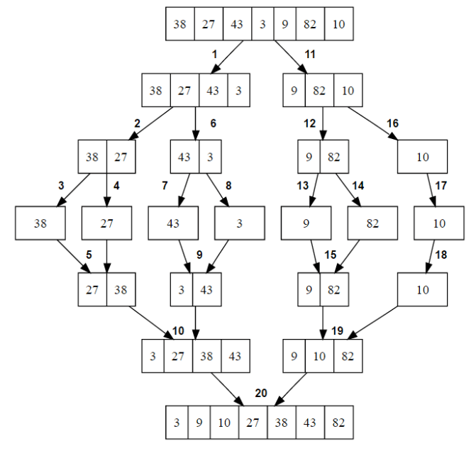

Slide 37
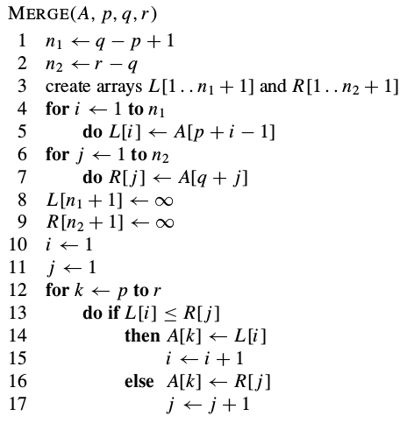
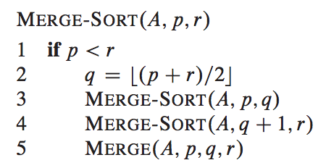
Pseudo Code

Slide 38
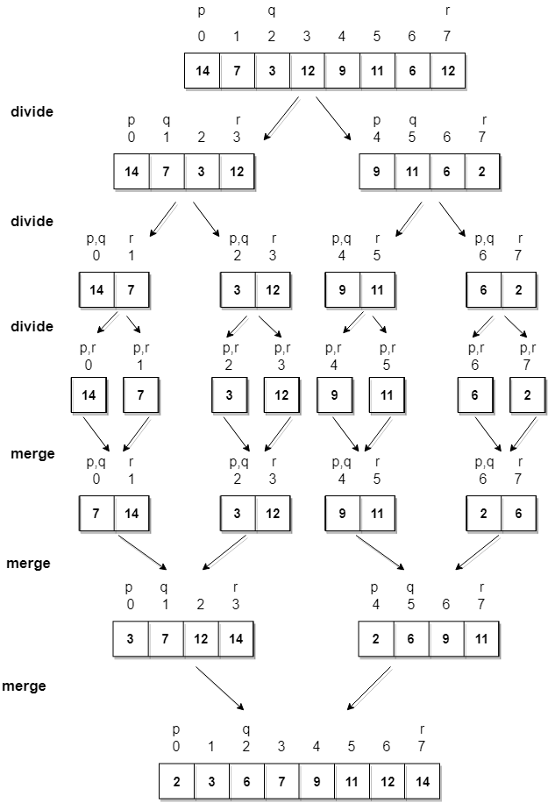

Slide 39
Merge List
test_list1 = [3, 4, 7, 8, 101] test_list2 = [1, 5, 65, 95, 111,123,143,197] size_1 = len(test_list1) size_2 = len(test_list2) res = [] i, j = 0, 0 while i < size_1 and j < size_2: if test_list1[i] < test_list2[j]: res.append(test_list1[i]) i += 1 else: res.append(test_list2[j]) j += 1 res = res + test_list1[i:] + test_list2[j:] print ("The combined sorted list is : " ,res)

Slide 40
Merge Sort
def merge(arr, l, m, r): n1 = m - l + 1 n2 = r - m L = [0] * (n1) R = [0] * (n2) for i in range(0, n1): L[i] = arr[l + i] for j in range(0, n2): R[j] = arr[m + 1 + j] i = 0 # Initial index of first subarray j = 0 # Initial index of second subarray k = l # Initial index of merged subarray

Slide 41
while i < n1 and j < n2: if L[i] <= R[j]: arr[k] = L[i] i += 1 else: arr[k] = R[j] j += 1 k += 1 while i < n1: arr[k] = L[i] i += 1 k += 1 while j < n2: arr[k] = R[j] j += 1 k += 1

Slide 42
def mergeSort(arr, l, r): if l < r: m = (l + (r - 1)) // 2 mergeSort(arr, l, m) mergeSort(arr, m + 1, r) merge(arr, l, m, r) arr = [12, 11, 13, 5, 6, 7] n = len(arr) print("Given array is") for i in range(n): print("%d" % arr[i]), mergeSort(arr, 0, n - 1) print("\n\nSorted array is") for i in range(n): print("%d" % arr[i])

